Slide 1
Project4 Presentation
Team 02 : 김병주, 김찬현, 김태훈, 박준형, 최종윤

Slide 2
Sokoban

Slide 3
Development Environment
Microsoft Visual Studio 2019
Version included Window API

Slide 4





Game overview(What)
CurrentX
CurrentY
Move up/down/left/right

Slide 5
Implementation Issue(How)
WinMain
WinProc
WM_CREATE
WM_KEYDOWN
WM_PAINT
WM_DESTROY

Slide 6
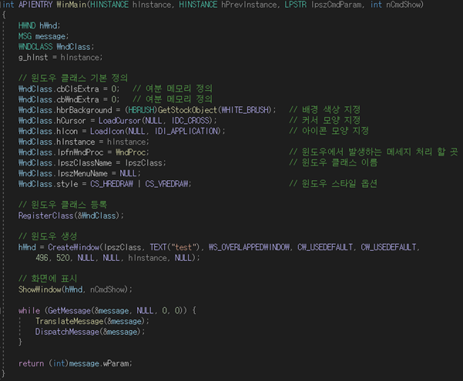




WinMain
Create a window class and set several values.
RegisterClass() :
register the window class to create a window
ShowWindow() :
show your window on the screen
GetMessage(), TranslateMessage() and DispatchMessage() :
get the message which is the user’s input such as keyboard and mouse

Slide 7
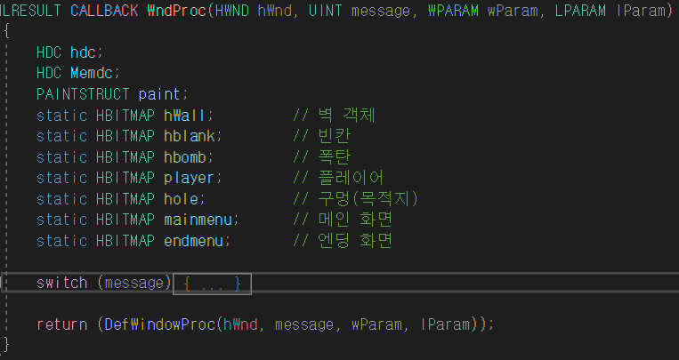
WinProc
Proper reaction of each changes will be described by using switch statement.

Slide 8
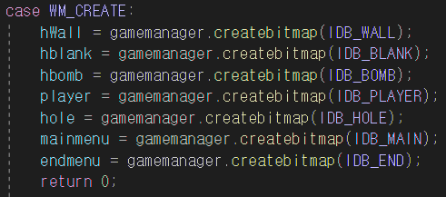
Switch - WM_CREATE
Create bitmap variable to load bitmap image for each block

Slide 9
Switch – WM_KEYDOWN
direction button (call move function for each direction)
space bar (show up the main page from the start page)
‘R’ (restore the starting state of the stage)
‘P’ (skip this stage and move on to the next stage)
‘ESC’ (finish the program)

Slide 10
Direction Button
VK_UP : player moves up
VK_DOWN : player moves down
VK_LEFT : player moves left
VK_RIGHT : player moves right

Slide 11
Direction Button(cont.)
If there is a wall on the direction where player moves, player don’t move.
If there is a bomb where player moves, then player and bomb move together.
If there is a bomb in the house where player moves, then player and bomb move together.
These rules apply to Up, Down, Left, and Right key.

Slide 12
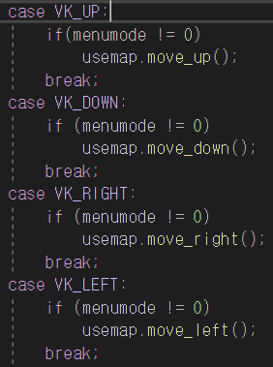
Direction Button(cont.)

Slide 13
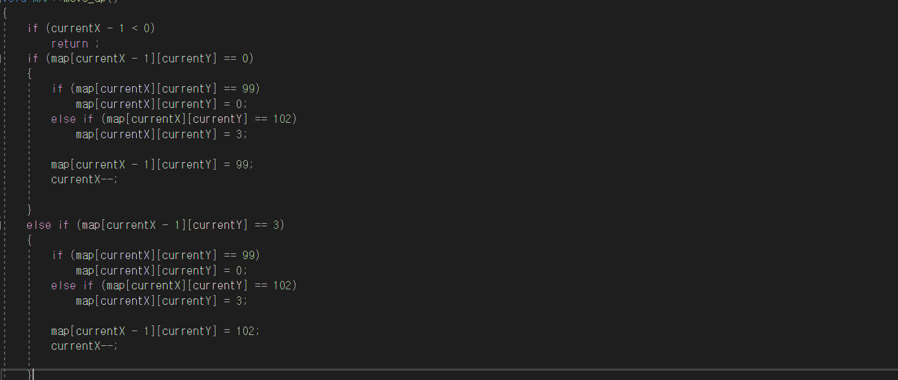
Map - move_up

Slide 14
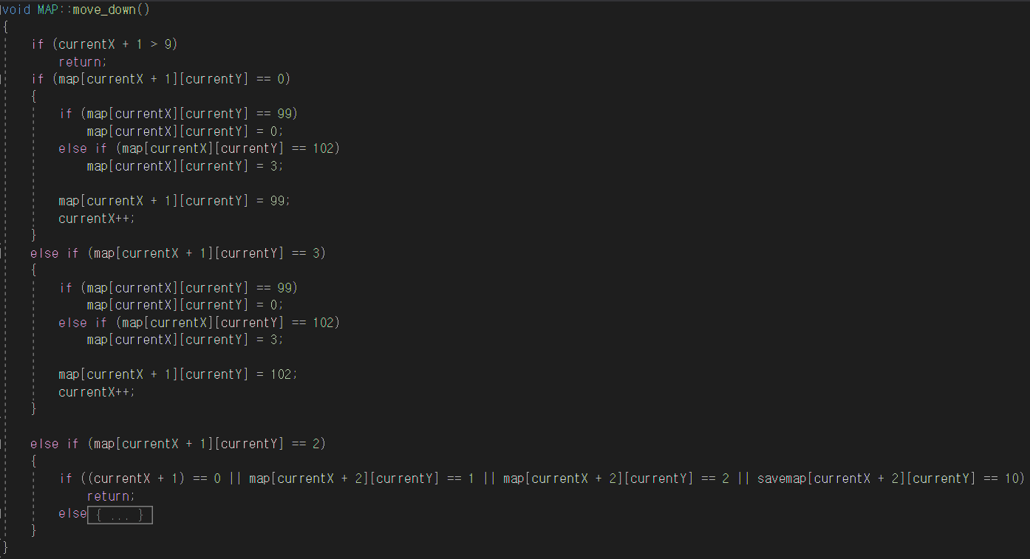
Map - move_down

Slide 15
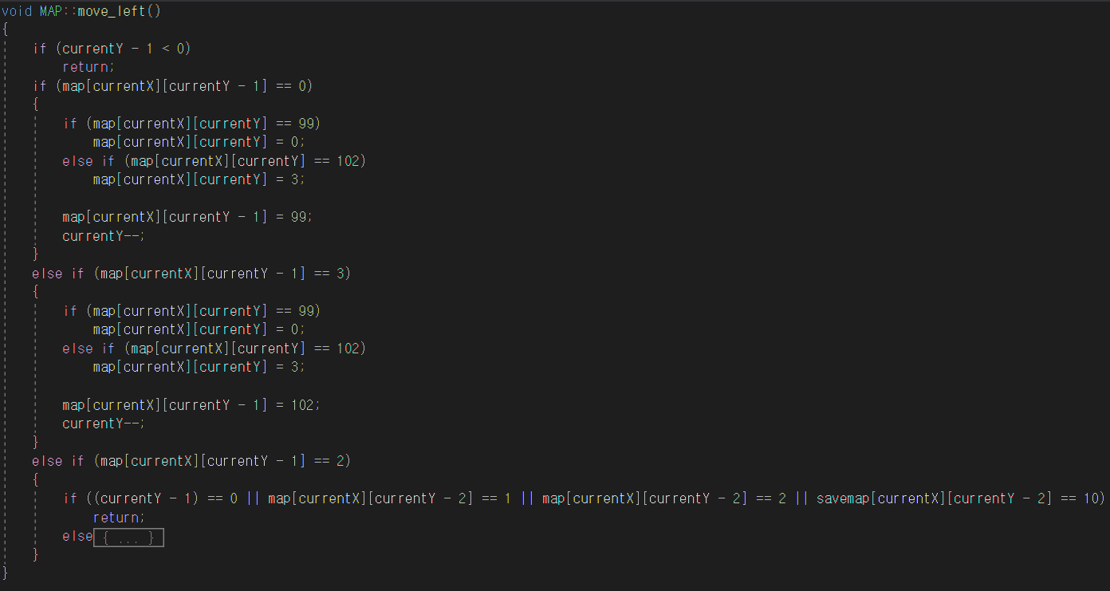
Map - move_left

Slide 16
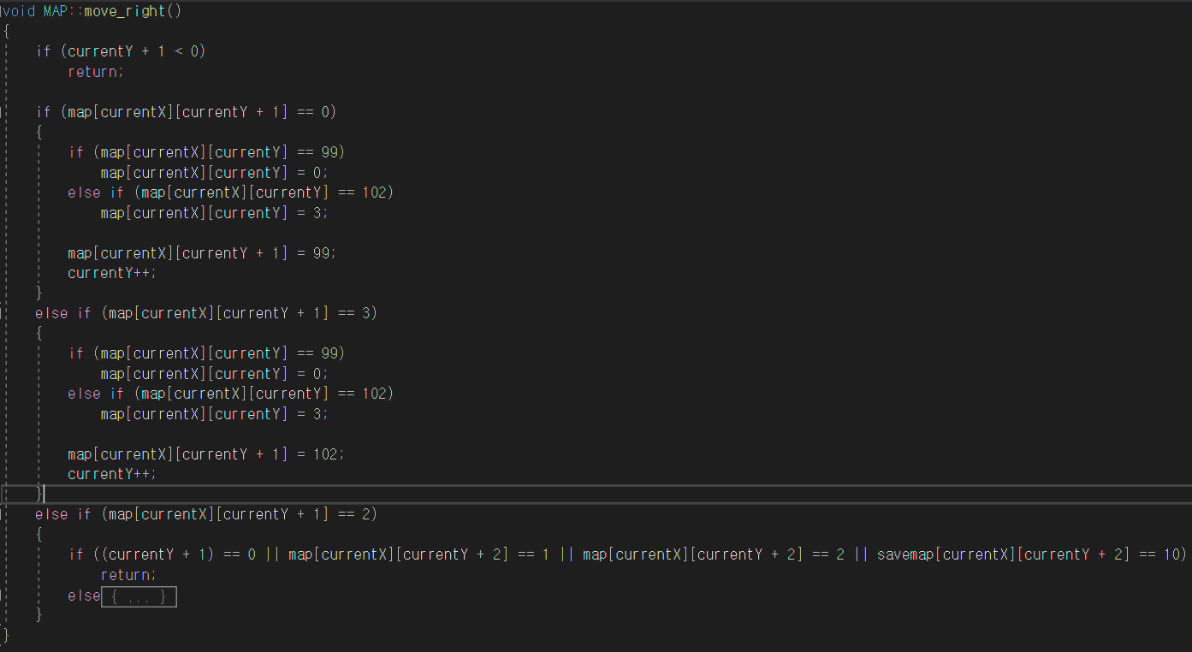
Map - move_right

Slide 17
Switch - WM_PAINT
draw() : draw each blocks on the screen
map status == 99
0
1
2
3

Slide 18
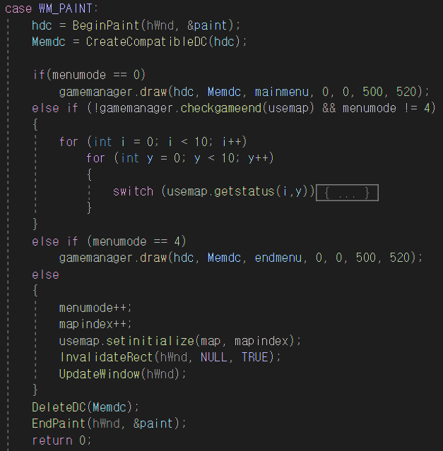
Switch - WM_PAINT(Cont.)

Slide 19
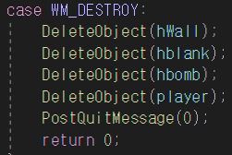
Switch - WM_DESTROY
destroy bitmap variables after used.

Slide 20
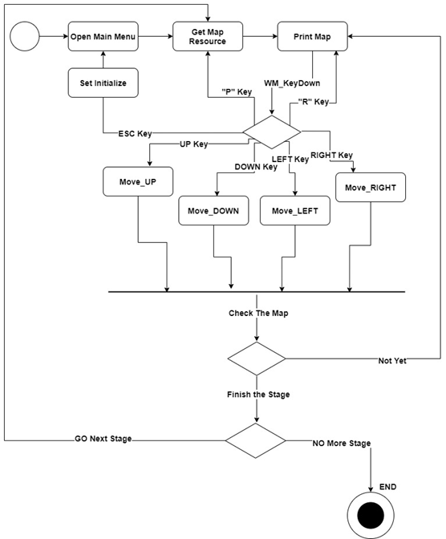
Activity Diagram

Slide 21
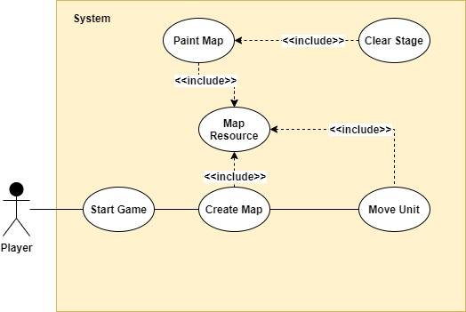
Use-case Diagram

Slide 22
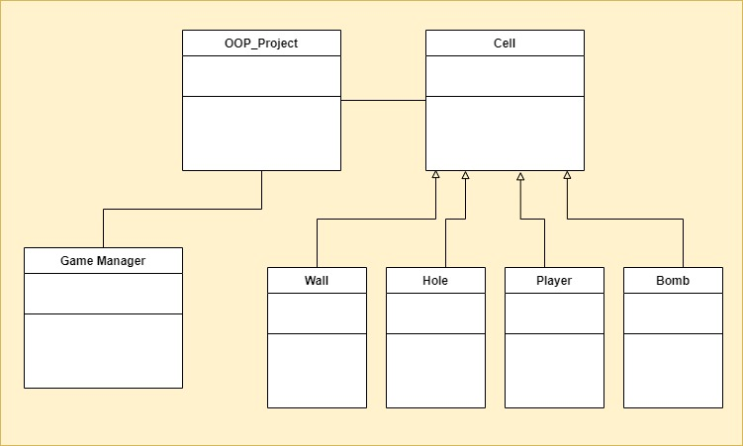
Class Diagram

Slide 23
OOP concepts
- Inheritance
We created Cell class that as a superclass that represents each blocks on the map. Then wall, home, bomb and player class were inherited Cell class as a child class. Because they have similarity as a block on the map and they all have coordinates of the block on the map.
- Polymorphism
Cell class has draw function that draw Bitmap image on the screen but each child class needs different kind of image so we have to override draw function in each child class.
- Encapsulation
By declaring each cell’s variable as private, reliability of those variables from each function could be increased.

Slide 24
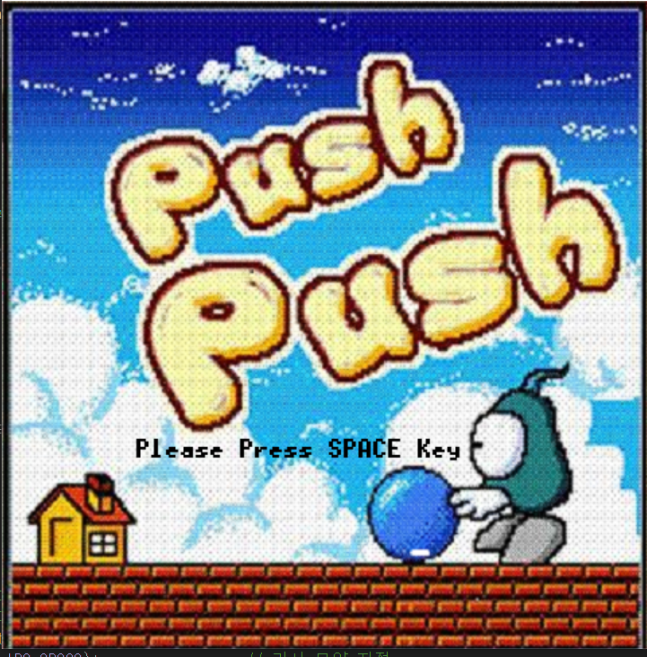
DEMO

Slide 25

Q&A

